Slide 1
HR ANALYSIS – EMPLOYEE RETENTION
Using Excel, Power BI, Tableau, MySQL
GROUP IV :-
Diksha Gupta
Nandini Gupta
Prakruti Pandya
Priyanka R
Suchitra K
Subhadip Ghosh
Bayisetti Bala Manikanta

Slide 2
OBJECTIVE
Identify key factors influencing employee attrition
Highlight workforce strengths and gaps
Understand employee behavior and satisfaction patterns
Develop predictive insights
Evaluate the effectiveness of promotion cycles and career progression
Provide HR teams with actionable insights
Measure the impact of monthly income, performance ratings
Support strategic planning
Analyze retention trends across departments
Build interactive dashboards

Slide 3
KPI’s
Total Employees
50000
Active Employees
24895
Attrition Rate
50.21%
Average Hourly Rate
114.45 Rs/Hour
Average Salary Hike
24.62%
Avg Job Satisfaction
2.49
Average Salary
₹ 26016
Average Age
39
Average Daily Rate
₹ 794.28

Slide 4
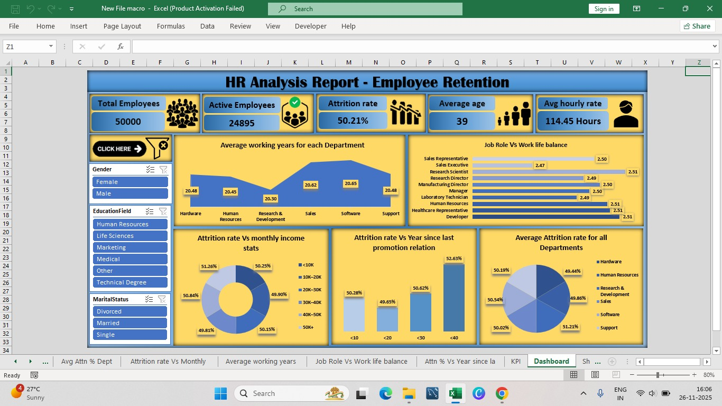
EXCEL DASHBOARD

Slide 5
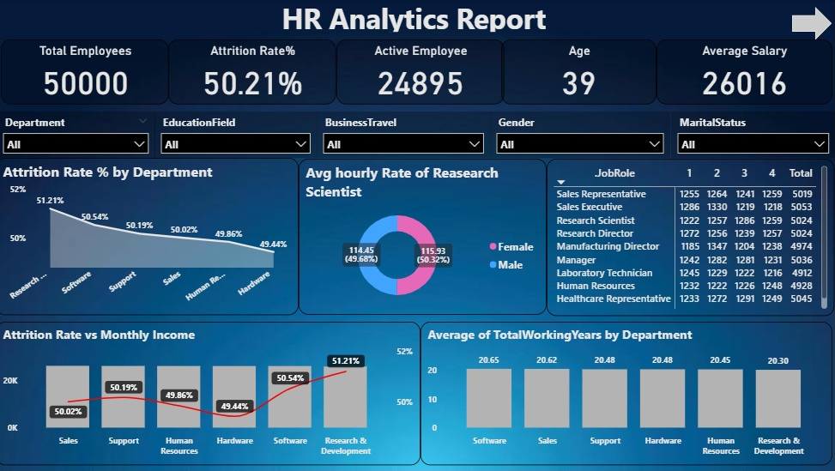
POWER BI DASHBOARD

Slide 6
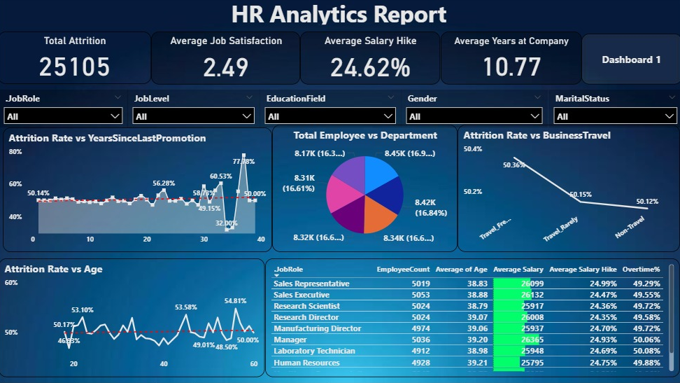

Slide 7
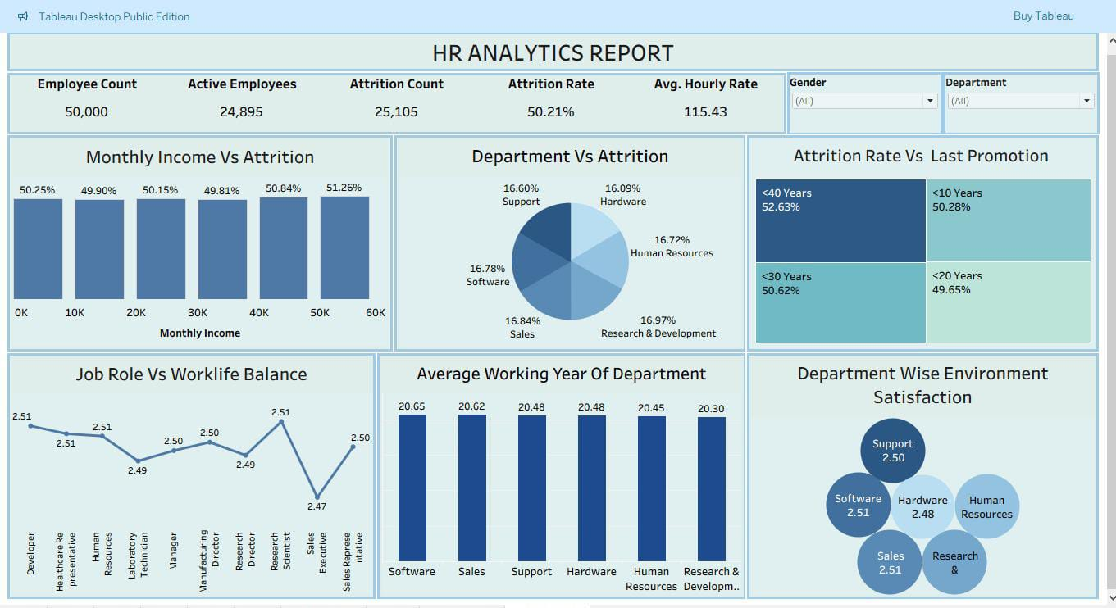
TABLEAU DASHBOARD

Slide 8
MYSQL SCRIPT

Slide 9
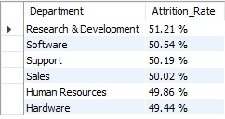
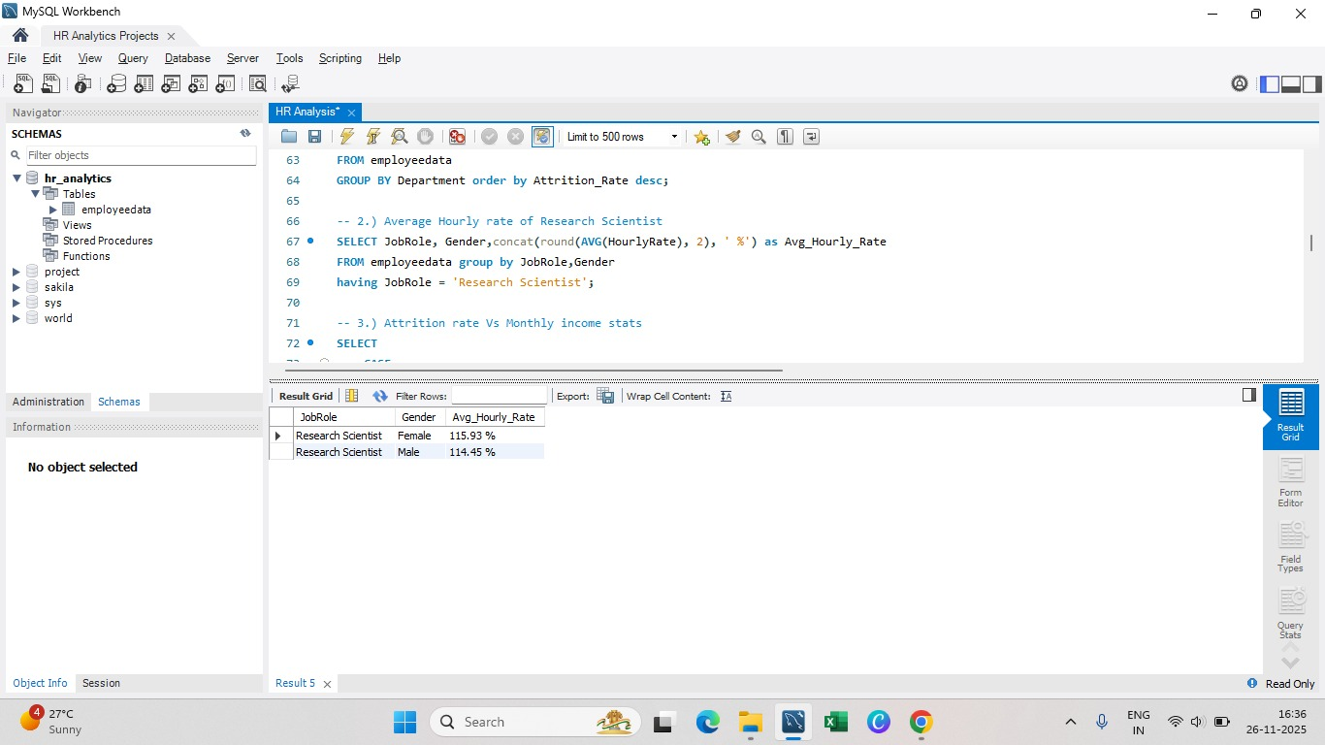
1. Average Attrition rate for all Departments
2. Average Hourly rate of Research Scientist
SELECT Department, CONCAT(ROUND(AVG(CASE WHEN Attrition = 'Yes' THEN 1.0 ELSE 0.0 END) * 100, 2), ' %') as Attrition_Rate FROM employeedata GROUP BY Department order by Attrition_Rate desc;
SELECT JobRole , Gender, concat(round(AVG(HourlyRate), 2), ' %’)
as Avg_Hourly_Rate FROM employeedata group by JobRole , Gender having JobRole
= 'Research Scientist';

Slide 10
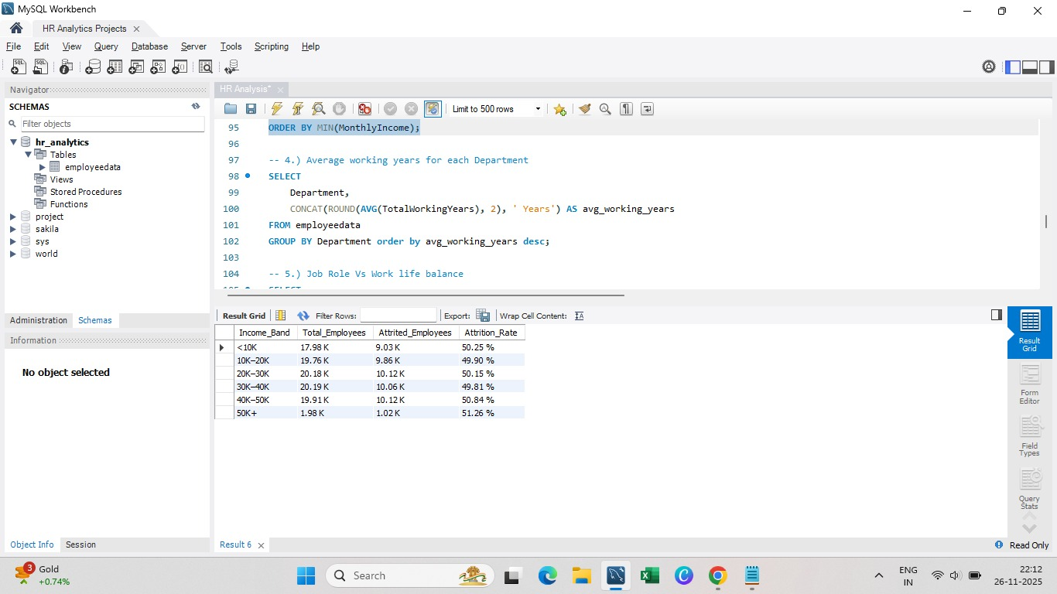
3. Attrition rate Vs Monthly income stats
SELECT CASE WHEN MonthlyIncome < 10000 THEN '<10K'
WHEN MonthlyIncome BETWEEN 10000 AND 19999 THEN '10K–20K’
WHEN MonthlyIncome BETWEEN 20000 AND 29999 THEN '20K–30K'
WHEN MonthlyIncome BETWEEN 30000 AND 39999 THEN '30K–40K'
WHEN MonthlyIncome BETWEEN 40000 AND 49999 THEN '40K–50K'
ELSE '50K+’ END AS Income_Band,
CONCAT(ROUND(COUNT(*) / 1000, 2), ' K') AS Total_Employees,
CONCAT(ROUND(SUM(CASE WHEN Attrition = 'Yes' THEN 1 ELSE 0 END) / 1000, 2), ' K') AS Attrited_Employees,
CONCAT(ROUND((SUM(CASE WHEN Attrition = 'Yes' THEN 1 ELSE 0 END) * 100.0) / COUNT(*), 2), ' %') AS Attrition_Rate FROM Employeedata GROUP BY Income_Band ORDER BY MIN(MonthlyIncome);

Slide 11
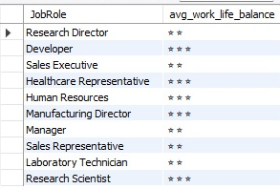
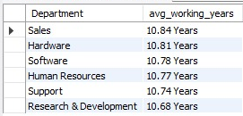
4. Average working years for each Dept
5. Job Role Vs Work life balance
SELECT Department, CONCAT(ROUND(AVG(YearsAtCompany), 2), ' Years') AS avg_working_years FROM employeedata GROUP BY Department order by avg_working_years desc;
SELECT JobRole, REPEAT('⭐', ROUND(AVG(WorkLifeBalance))) AS avg_work_life_balance FROM employeedata GROUP BY JobRole;

Slide 12
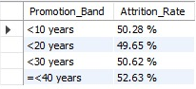
6. Attrition rate Vs Year since last promotion relation
SELECT CASE
WHEN YearsSinceLastPromotion < 10 THEN '<10 years'
WHEN YearsSinceLastPromotion < 20 THEN '<20 years'
WHEN YearsSinceLastPromotion < 30 THEN '<30 years'
ELSE '=<40 years' END AS Promotion_Band,
concat(round((SUM(CASE WHEN Attrition = 'Yes' THEN 1 ELSE 0 END) * 100.0) / COUNT(*), 2)," %" ) AS Attrition_Rate FROM Employeedata GROUP BY Promotion_Band
ORDER BY MIN(YearsSinceLastPromotion);

Slide 13
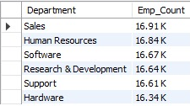
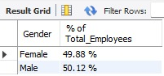
7. Department wise No of Employees
8. Gender based Percentage of Employee
SELECT Department , CONCAT(ROUND(SUM(EmployeeCount)/1000, 2), ' K') AS Emp_Count
FROM employeedata
GROUP BY Department order by
Emp_Count desc;
SELECT Gender, CONCAT(FORMAT((COUNT(Gender) * 100.0 / (SELECT COUNT(*) FROM employeedata)), 2), ' %') AS % of Total_Employees
FROM employeedata GROUP BY Gender;

Slide 14
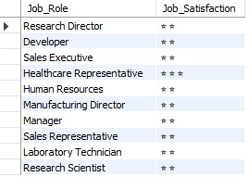
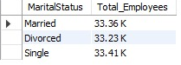
9. Job Role wise job satisfaction
10. Total employees based on marital status
SELECT JobRole as Job_Role,
REPEAT('⭐', ROUND(AVG(JobSatisfaction))) AS Job_Satisfaction
FROM employeedata GROUP BY JobRole;
SELECT MaritalStatus, CONCAT(ROUND(COUNT(EmployeeID) / 1000, 2), ' K') AS Total_Employees
FROM employeedata
GROUP BY MaritalStatus;

Slide 15
SUGGESTIONS
Based on the all analysis, the following strategic suggestions can be made to improve retention:
Review compensation structures: Conduct a market analysis to ensure competitive and fair compensation for all roles, with adjustments made where necessary.
Enhance career development programs: Create clear career pathways and continuous learning and development opportunities.
Improve work-life balance: Implement policies that support flexible work schedules, telecommuting options, and ensure workloads are manageable.
Refine onboarding processes: Strengthen the onboarding program to better integrate new hires into the company culture and clarify role expectations.
Leadership training: Train managers and leaders in effective people management, focusing on communication, feedback, and recognition.

Slide 16
CONCLUSION
By applying the findings across HR functions—
Compensation
Training
Planning
Culture building
Organizations can greatly improve retention and build a stronger workforce.

Slide 17
THANK YOU

